Slide 1
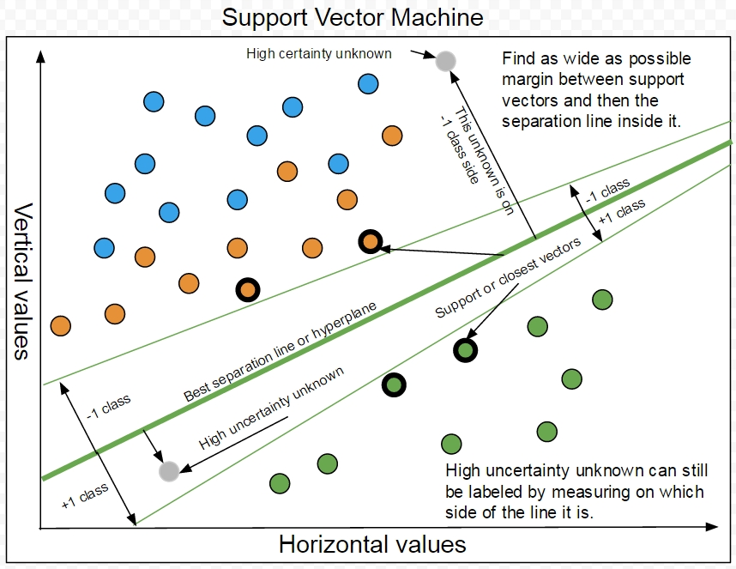
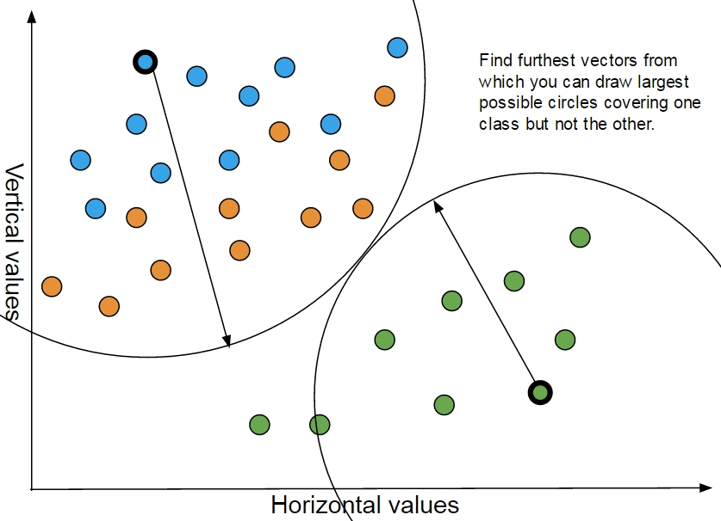
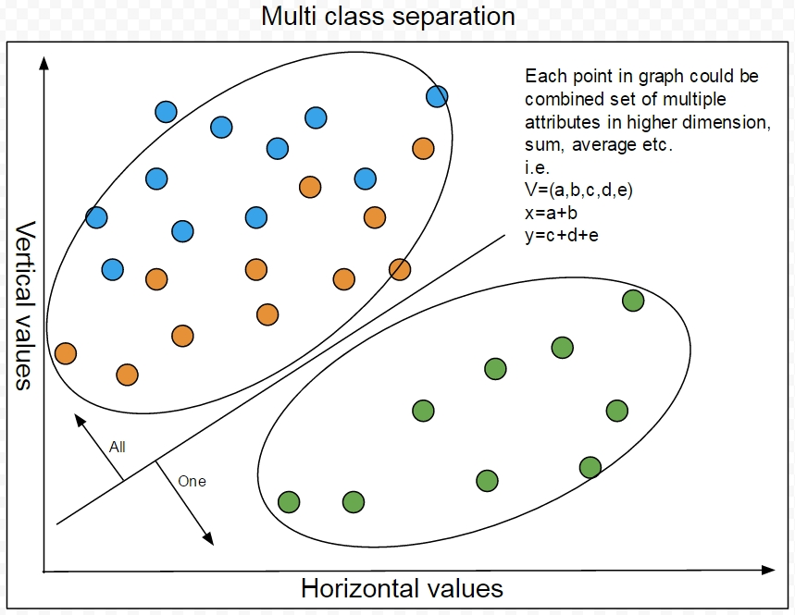
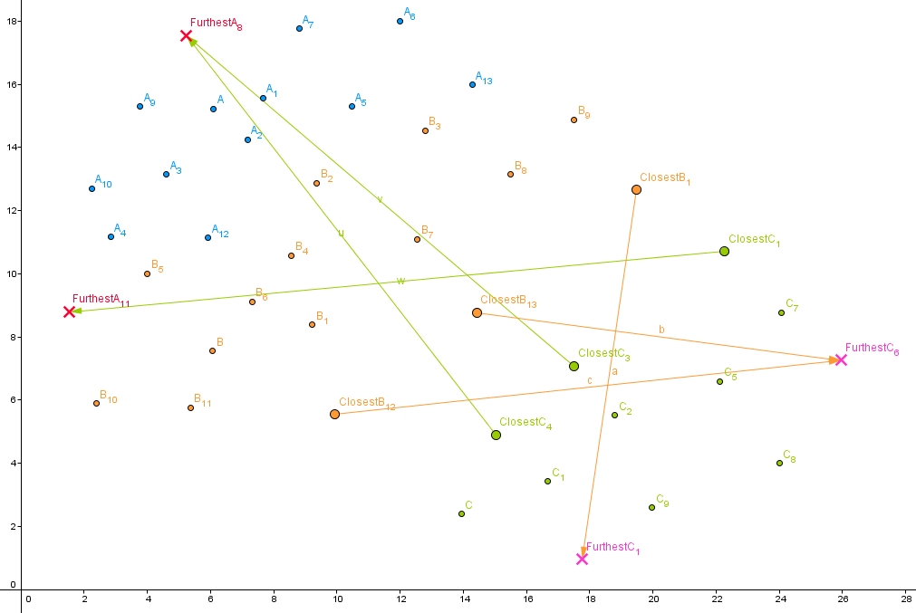
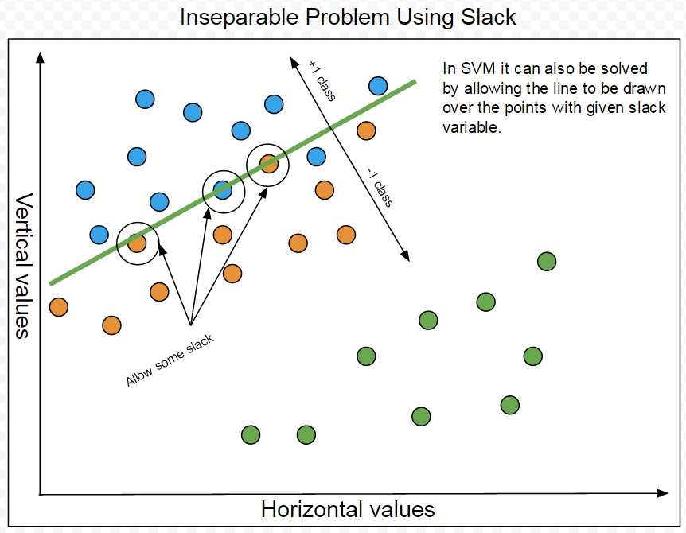
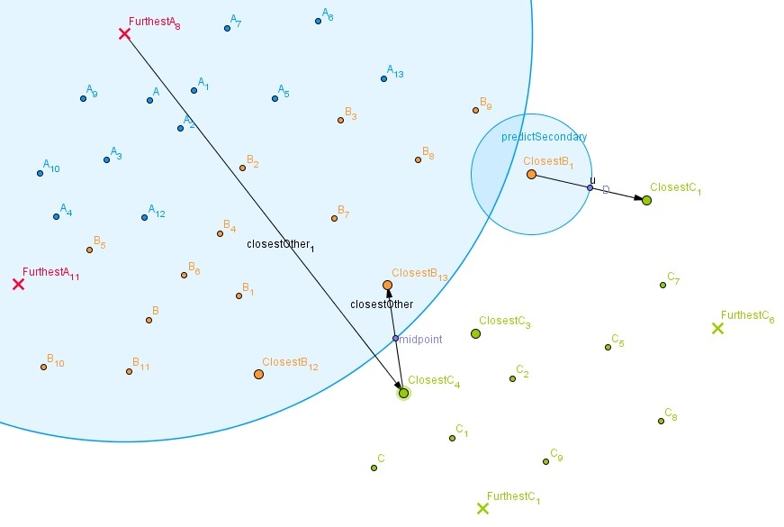
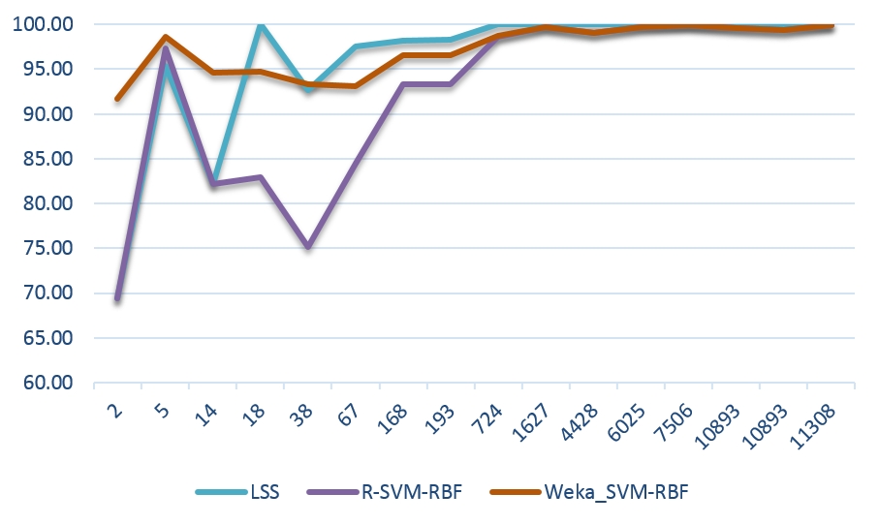
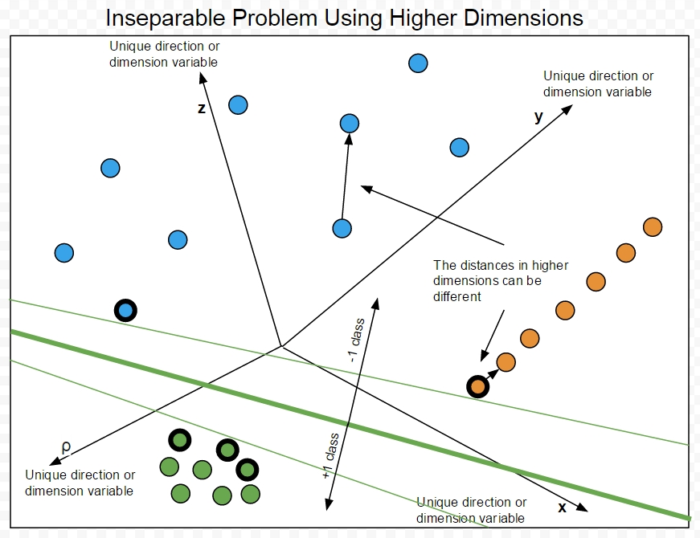
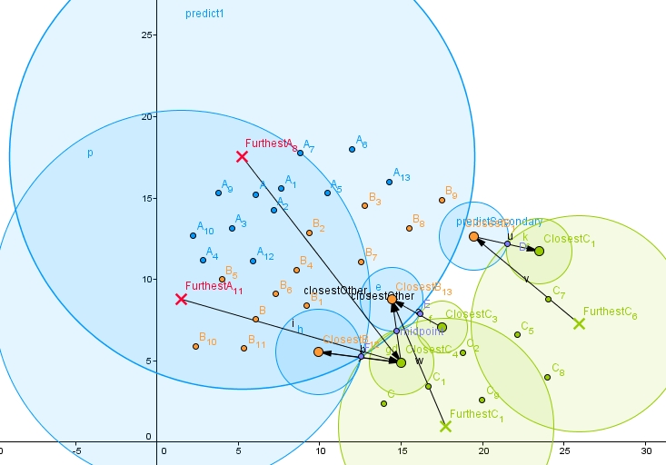
A Guide to Machine Learning and Bioinformatics
(Support Vector Machine interpretation as Least Similar Spheres)
Author: Gintaras Koncevicius Supervisor: Ray Ruocco
Introduction
Machine learning use and improvement in biotechnology “will have numerous benefits such as efficiency, cost effectiveness, time saving” (S. Mandal et al., 2009, p90). One of the highest precision techniques is Support Vector Machine or SVM and that’s why “support vector machine learning algorithm has been extensively applied within the field of computational biology” (W. Noble, 2003, p1).
Support Vector Machine
Least Similar Spheres
Problem
Bioinformatics is one of the fields where many seemingly different sciences join in collaboration to solve the problem. Author offers to bridge the increasing knowledge gap between experts and beginners in this field, by educating about it with examples and interpreted implementation used on real data.
Methods
Datasets of drug and receptor binding called bioassay.
Comparing results with SVM implementations in Weka and R software.
Unique interpretation of SVM written in Java.
Learning Phase, find closest and furthest vectors
Results and Conclusion
Similar results to R-SVM might indicate that implemented algorithm actually works.
Machine learning has been and will be useful in biotechnology even with low precision, because it can still be used to reduce the search space.
Large dataset results support that bigger data allow higher precision.
Different machine learning interpretation could outperform others in some cases and become new technique for certain problems.
Predict phase, each class each furthest sphere.
Size of data and precision of algorithms
References
Mandal, S., Moudgil, M. and Mandal, S. (2009)., 625(1-3), pp.90-100. Rational drug design. European Journal of Pharmacology
Noble, S. (2003). Support vector machine applications in computational biology. Washington University Department of Genome Sciences, pp.1-31.
Predict phase, all furthest spheres.
Acknowledgments
I would like to show my gratitude to my supervisor Mr Ray Ruocco, for having enough patience to help deal with this project implementation uncertainties and problems. I would also like to thank Dr Aaron Kans, Dr Sin Wee Lee, Dr Paolo Falcarin for teaching programming modules in a way it gave me enough confidence and skill to deal with this project.

